Slide 1
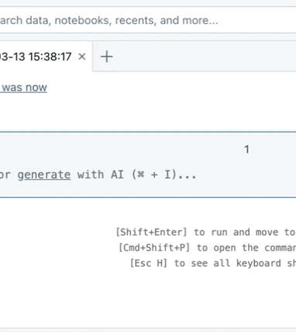
TRAINER DECK
Azure Databricks
Lessons 1 and 2
From first workspace navigation to a governed Delta table
14 learners • one Premium workspace • one schema each
Notes:
Open with the concrete outcome: every learner will create and validate a governed Delta table. Set the expectation that menu labels can vary slightly by tenant and release.
Sources:
https://learn.microsoft.com/azure/databricks/admin/workspace/create-workspace
https://learn.microsoft.com/azure/databricks/notebooks/notebooks-manage

Slide 2
What learners will be able to do
Two lessons, one complete data path
Explain
Build
Publish
Describe workspace, notebook, compute, Spark, Unity Catalog and Delta in plain language.
Create a DataFrame, transform it, expose a temporary view and query with SQL.
Save into catalog.schema.table and validate data, metadata and history.
Final evidence training_lab.student_XX.orders
AZURE DATABRICKS • LESSONS 1–2
02
Notes:
Ask learners which outcome feels newest. Use their response to tune the pace. Stress that the final evidence includes both a query result and DESCRIBE HISTORY.
Sources:

Slide 3
The business story
Five retail orders become a trusted table
SOURCE
PROCESS
PUBLISH
Small order data
Spark DataFrame
Governed Delta table
order_id
product
quantity
unit_price
→
Filter invalid rows
Calculate order_total
Summarize by product
→
training_lab.student_01.orders
Query • history • time travel
Use the same story across explanation, demo, lab and assessment.
AZURE DATABRICKS • LESSONS 1–2
03
Notes:
Keep the scenario stable so learners spend cognitive effort on platform concepts, not on changing business examples.
Sources:

Slide 4
01
Lesson 1
Databricks foundations and Spark mental model
Concept → demonstration → guided lab → assessment
04
Notes:
Transition: first build the mental model, then use it.
Sources:

Slide 5
What Azure Databricks is
A managed data and AI platform built around Spark and the lakehouse
One workspace
Scalable execution
Governed assets
Notebooks, SQL, jobs and discovery for several roles.
Serverless or classic compute runs Spark and SQL workloads.
Unity Catalog controls and describes tables, files, models and more.
Managed platform ≠ data automatically becomes clean, governed or inexpensive.
AZURE DATABRICKS • LESSONS 1–2
05
Notes:
Define Databricks without marketing language. It supplies managed capabilities; teams still design data quality, permissions, costs and operations.
Sources:
https://learn.microsoft.com/azure/databricks/admin/workspace/create-workspace

Slide 6
The lakehouse idea
Open storage with reliable table behavior
Data lake strengths
Warehouse strengths
Lakehouse response
Low-cost cloud storage
Open file formats
Raw and refined data
Managed tables
SQL performance
Schema and access controls
Open formats + transactions
Engineering + BI + AI
Unified governance
Delta adds a transaction log to table data stored in Parquet.
AZURE DATABRICKS • LESSONS 1–2
06
Notes:
Avoid saying a lakehouse literally merges every capability perfectly. Explain it as an architectural pattern that brings table management to lake storage.
Sources:
https://learn.microsoft.com/azure/databricks/delta/tutorial

Slide 7
Five objects to remember
Use these names consistently throughout the class
1
2
3
4
5
Workspace
Notebook
Compute
Unity Catalog
Delta table
collaboration
code + results
execution
governance
reliable data
Notebook code runs on compute; governed tables live under Unity Catalog names.
AZURE DATABRICKS • LESSONS 1–2
07
Notes:
Use a pointing check: show each object in the UI or diagram and ask the class to name it.
Sources:

Slide 8
Workspace and compute choices
Select by policy, network and workload—not habit
Serverless
Classic all purpose
SQL warehouse
Fast startup
Infrastructure managed by Databricks
Best training default when enabled and approved
Interactive notebooks
Runtime and node configuration
Use policy and auto termination
SQL editor and BI queries
Optimized SQL experience
Not a general Python cluster
Workspace deployment may offer Serverless capabilities or a classic Hybrid model.
AZURE DATABRICKS • LESSONS 1–2
08
Notes:
Explain current deployment options carefully. Availability depends on region and tenant configuration. Premium is used here because the class includes Unity Catalog governance.
Sources:
https://learn.microsoft.com/azure/databricks/admin/workspace/create-workspace
https://learn.microsoft.com/azure/databricks/compute/configure

Slide 9
Architecture in one picture
Management, execution, storage and governance
Control plane
Compute plane
Cloud storage
Unity Catalog
Workspace UI
Notebook metadata
Service management
Driver
Executors
Spark tasks
Source files
Parquet data
Delta log
Names
Privileges
Lineage and discovery
Learner view
Open notebook → select compute → read or write a governed object
AZURE DATABRICKS • LESSONS 1–2
09
Notes:
State that networking detail differs by workspace and compute model. The diagram is a teaching abstraction, not a network design.
Sources:
https://learn.microsoft.com/azure/databricks/admin/workspace/create-workspace

Slide 10
Spark execution model
The driver coordinates work across executor processes
Executor A
DRIVER
Partition 1
Partition 2
tasks →
Storage
Builds plan
Schedules tasks
Collects status
Read partitions
Write result files
Commit Delta version
Executor B
Partition 3
Partition 4
AZURE DATABRICKS • LESSONS 1–2
10
Notes:
Connect to Java: driver resembles the coordinating main process; executors resemble worker processes. Correct the misconception that a DataFrame is fully stored in driver memory.
Sources:
https://spark.apache.org/docs/latest/

Slide 11
RDD, DataFrame and SQL
Three interfaces, one Spark engine
RDD
DataFrame
Spark SQL
Low-level distributed collection
Flexible but fewer structural optimization opportunities
Concept only in this course
Named columns and schema
Optimizable logical plan
Primary PySpark interface
Declarative SQL
Uses the same engine
Ideal for analysts and validation
Default choice for structured data: DataFrames and SQL.
AZURE DATABRICKS • LESSONS 1–2
11
Notes:
Do not imply RDDs are obsolete. State that DataFrames and SQL are usually preferable for structured analytics because Spark can reason about their schema and plan.
Sources:
https://spark.apache.org/docs/latest/

Slide 12
Lazy evaluation
Transformations build a plan; actions request a result
TRANSFORMATIONS
ACTIONS
DESCRIBE WORK
TRIGGER WORK
select
filter
withColumn
groupBy
LOGICAL PLAN
display
count
collect
write
→
→
Spark can reorder, prune and optimize operations before execution.
AZURE DATABRICKS • LESSONS 1–2
12
Notes:
Ask: if we define three transformations but never call display, count or write, what may happen? Expected: Spark builds a plan, but the full data job may not run yet.
Sources:
https://spark.apache.org/docs/latest/

Slide 13
Notebook essentials
Create, connect, run and validate in small steps
1 Create
2 Connect
3 Run
4 Validate
New → Notebook
Name by purpose
Select permitted
serverless or classic compute
Execute one safe cell
then Run all
Inspect schema
rows and errors
AZURE DATABRICKS • LESSONS 1–2
13
Notes:
Demonstrate the current toolbar. Explain that new notebooks may start in Drafts and can auto-connect to serverless in eligible Unity Catalog workspaces.
Sources:
https://learn.microsoft.com/azure/databricks/notebooks/notebooks-manage

Slide 14
Notebook languages and cell design
Keep setup, transformation, validation and publishing separate
PYTHON
SQL
from pyspark.sql import functions as F
orders_df = spark.createDataFrame(data, schema)
%sql
SELECT product, SUM(order_total)
FROM orders_work
GROUP BY product
Setup
Transform
Publish
Imports, parameters and source paths
Clean, derive and aggregate
Write, validate and record evidence
AZURE DATABRICKS • LESSONS 1–2
14
Notes:
Explain magic commands such as %sql only as needed. Separate destructive publish cells so learners do not rerun them accidentally.
Sources:
https://learn.microsoft.com/azure/databricks/notebooks/notebooks-manage

Slide 15
Choosing classic compute safely
Use the simplest policy-compliant configuration
Policy
Trainer-approved limits
Runtime
Current supported or approved LTS
Access mode
Standard for Unity Catalog
Autoscaling
Small minimum and maximum
Auto termination
Mandatory for interactive labs
Use serverless instead when enabled, approved and suitable.
AZURE DATABRICKS • LESSONS 1–2
15
Notes:
Do not teach learners to choose large nodes by guesswork. Use a restrictive policy and auto termination for shared training.
Sources:
https://learn.microsoft.com/azure/databricks/compute/configure

Slide 16
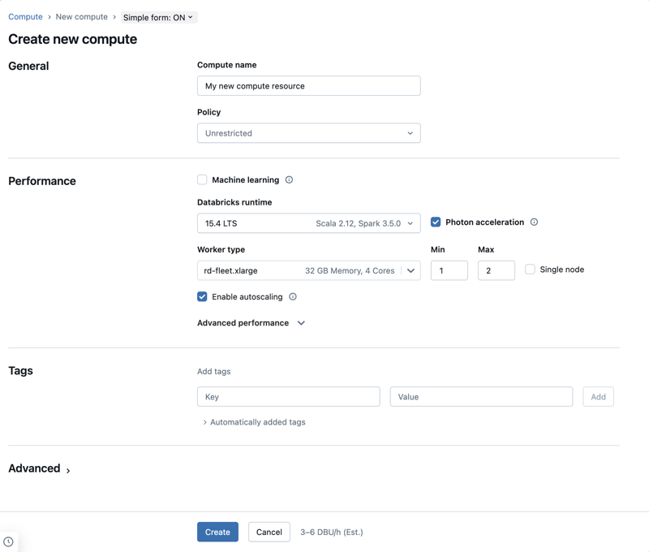
Recent compute configuration UI
Fields vary by policy and workspace capability
Check policy
The policy controls permitted runtimes, sizes and limits.
Check access mode
Use a Unity Catalog-compatible mode approved for the class.
Check cost controls
Small limits and auto termination reduce idle spend.
AZURE DATABRICKS • LESSONS 1–2
16
Notes:
Point out that the screenshot is a recent simple form and the learner tenant can show fewer or more fields. Focus on decisions, not memorized positions.
Sources:
https://learn.microsoft.com/azure/databricks/compute/configure

Slide 17
Lesson 1 demonstration flow
Create the notebook, build the DataFrame, then query it
01 Create 01 Foundations Orders
02 Verify compute with spark.range(5)
03 Create orders_df and printSchema
04 Derive order_total and display
05 Register orders_work and run SQL
AZURE DATABRICKS • LESSONS 1–2
17
Notes:
Pause before display and ask learners to predict the highest order total. Pause before SQL and ask whether the temporary view is permanent.
Sources:
https://learn.microsoft.com/azure/databricks/notebooks/notebooks-manage

Slide 18
CSV, JSON, Parquet and Delta
Choose a format based on structure and reliability needs
CSV
JSON
Parquet
Delta
Exchange
Events
Analytics
Trusted tables
Simple, no embedded types
Nested but verbose
Columnar and compressed
Parquet + transaction log
Parquet is columnar—but transactions, history and time travel come from Delta.
AZURE DATABRICKS • LESSONS 1–2
18
Notes:
Ask which format they would choose for an API payload, an analytics extract and a trusted table. Clarify that Delta data files are Parquet plus a transaction log.
Sources:
https://learn.microsoft.com/azure/databricks/delta/tutorial

Slide 19
Build the orders DataFrame
A tiny input teaches the same API used at larger scale
PYTHON
orders_df = spark.createDataFrame([
(1001, 'Keyboard', 2, 45.00),
(1002, 'Mouse', 1, 25.00),
(1003, 'Monitor', 2, 220.00)
], ['order_id','product','quantity','unit_price'])
Schema
Named columns let Spark plan expressions.
Partitions
Rows can be processed across executor tasks.
Same API
The sample is small; the DataFrame model scales.
AZURE DATABRICKS • LESSONS 1–2
19
Notes:
Say explicitly that this small sample is not proof of performance. It is a controlled way to learn the API and execution model.
Sources:

Slide 20
Transformations and actions in code
Name what is lazy and what triggers execution
PYTHON
result_df = (orders_df
.filter(F.col('quantity') > 0)
.withColumn('order_total',
F.round(F.col('quantity') * F.col('unit_price'), 2))
.select('order_id','product','quantity','unit_price','order_total'))
display(result_df)
Transformations
filter
withColumn
select
Action
display
Predict first. Run second. Validate third.
AZURE DATABRICKS • LESSONS 1–2
20
Notes:
Correct Java assumptions: withColumn returns a new DataFrame; it does not mutate the original like a setter. display is a Databricks notebook action that requests results.
Sources:
https://spark.apache.org/docs/latest/

Slide 21
Spark SQL uses the same engine
A temporary view bridges DataFrame code and SQL
PYTHON
SQL
result_df.createOrReplaceTempView('orders_work')
%sql
SELECT product, SUM(quantity) AS units,
ROUND(SUM(order_total), 2) AS revenue
FROM orders_work
GROUP BY product
ORDER BY revenue DESC
Expected leader
Monitor
2 units
440.00 revenue
Temporary view = session-scoped name, not a governed table.
AZURE DATABRICKS • LESSONS 1–2
21
Notes:
Ask whether another job can reliably discover orders_work tomorrow. Expected: no; it is a temporary view in the current Spark session.
Sources:

Slide 22
02
Lesson 2
Unity Catalog governance and Delta publishing
Concept → demonstration → guided lab → assessment
22
Notes:
Transition: the DataFrame works, but it is temporary. Now publish it as a named, governed table.
Sources:

Slide 23
Unity Catalog hierarchy
Three levels make the target explicit
training_lab
.
student_01
.
orders
Catalog
Schema
Table
Training domain or environment
Learner ownership area
Governed dataset
AZURE DATABRICKS • LESSONS 1–2
23
Notes:
Have learners translate the name aloud. Then substitute student_07 and product_summary to check that the structure—not the memorized string—is understood.
Sources:

Slide 24
One workspace, fourteen learner schemas
Isolation without fourteen separate workspaces
Premium Azure Databricks workspace
student_01
student_02
student_03
student_04
student_05
student_06
student_07
CREATE TABLE
CREATE TABLE
CREATE TABLE
CREATE TABLE
CREATE TABLE
CREATE TABLE
CREATE TABLE
student_08
student_09
student_10
student_11
student_12
student_13
student_14
CREATE TABLE
CREATE TABLE
CREATE TABLE
CREATE TABLE
CREATE TABLE
CREATE TABLE
CREATE TABLE
Shared group entitlement + narrow schema privileges + assigned names
AZURE DATABRICKS • LESSONS 1–2
24
Notes:
Explain the operational benefit and the security limits. Schema privileges control governed objects, but workspace and compute entitlements still matter.
Sources:

Slide 25
Why Delta is more than a format
Parquet data plus a transaction log
Reliable commits
Controlled structure
Auditable evolution
ACID transactions expose a consistent table version.
Schema enforcement catches unexpected changes.
History and time travel expose prior versions.
The log records committed table changes—not just filenames.
AZURE DATABRICKS • LESSONS 1–2
25
Notes:
Describe Delta as a table protocol and transaction log around Parquet data. Do not reduce it to a file extension.
Sources:
https://learn.microsoft.com/azure/databricks/delta/tutorial

Slide 26
Save the result as a governed Delta table
The three-level target is the safety boundary
PYTHON
result_df.write \
.format('delta') \
.mode('overwrite') \
.saveAsTable('training_lab.student_01.orders')
format
Use the Delta table provider.
mode
Overwrite makes the isolated lab rerunnable.
saveAsTable
Persist and register the governed name.
Before overwrite, say the full object name out loud.
AZURE DATABRICKS • LESSONS 1–2
26
Notes:
Narrate every line. Overwrite is acceptable only because each learner owns an isolated lab target. In production, require validation, ownership and recovery rules.
Sources:
https://learn.microsoft.com/azure/databricks/delta/tutorial

Slide 27
Write modes, MERGE and reruns
Choose behavior deliberately
overwrite
append
MERGE
error if exists
Replace lab contents
Good for isolated reruns
Risky on shared targets
Add every input row
Simple event ingestion
Can duplicate reruns
Match on business key
Update and insert
Validate source uniqueness
Fail safely
Protect accidental replacement
Useful creation default
Mode is a business decision encoded in one method call.
AZURE DATABRICKS • LESSONS 1–2
27
Notes:
Ask which key should match orders. Explain that MERGE is not automatically safe: duplicate source keys can still create ambiguous outcomes.
Sources:
https://learn.microsoft.com/azure/databricks/delta/tutorial

Slide 28
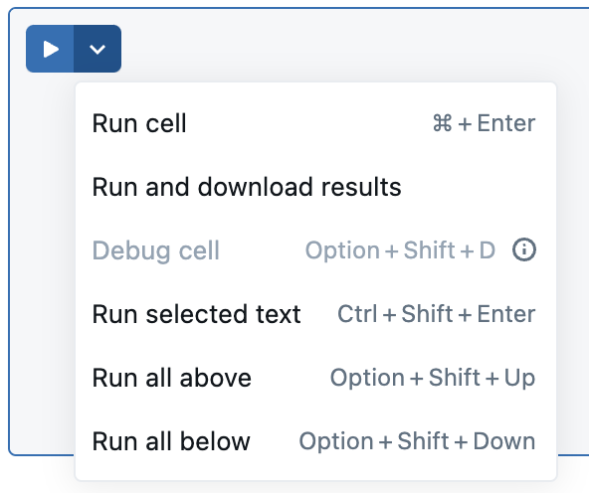
End-to-end learner lab
From notebook to evidence in five checkpoints
1
Connect and verify compute
2
Create and transform orders_df
3
Query orders_work with SQL
4
Write training_lab.student_XX.orders
5
Validate data, detail and history
AZURE DATABRICKS • LESSONS 1–2
28
Notes:
Learners use their assigned schema, not always student_01. Require evidence after each checkpoint so troubleshooting is localized.
Sources:
https://learn.microsoft.com/azure/databricks/notebooks/notebooks-manage
https://learn.microsoft.com/azure/databricks/delta/tutorial

Slide 29
Troubleshooting by evidence
Read the exact error before changing permissions or code
Detached notebook
→
Compute selector and policy
PERMISSION_DENIED
→
Identity, object name and SHOW GRANTS
TABLE_OR_VIEW_NOT_FOUND
→
Catalog, schema and spelling
COLUMN_NOT_FOUND
→
printSchema and input sample
Unexpected duplicates
→
History and business-key counts
Narrow fix > broad admin access
AZURE DATABRICKS • LESSONS 1–2
29
Notes:
Treat permission errors as evidence. Fix the narrow missing grant rather than making the learner an admin. For rerun differences, inspect DESCRIBE HISTORY before overwriting.
Sources:
https://learn.microsoft.com/azure/databricks/compute/configure
https://learn.microsoft.com/azure/databricks/delta/tutorial

Slide 30
Assessment and close
A learner passes by explaining and proving the workflow
Explain
Demonstrate
Judge
Workspace vs compute
Transformation vs action
catalog.schema.table
Correct totals
Governed orders table
History and second version
Overwrite risk
Append vs MERGE
Least-privilege response
Notebook → Spark → Unity Catalog → Delta table → evidence
Next: automate the path with jobs and reliable ingestion patterns.
AZURE DATABRICKS • LESSONS 1–2
30
Notes:
Close by asking one learner to explain the full path without notes. Collect the table query, DESCRIBE HISTORY and product_summary challenge as evidence.
Sources:

Slide 31
03
Live demonstration
A complete instructor walkthrough with expected results
Concept → demonstration → guided lab → assessment
31
Notes:
This section is the demonstration edition of the deck. Keep the lab guide open beside the presentation. Run each example only after learners predict its result.
Sources:

Slide 32
Live demonstration setup
Prepare three windows before learners join
Azure portal
Databricks workspace
Trainer notebook
Workspace resource
Subscription and resource group
Deployment status
Workspace navigation
Compute selector
Catalog Explorer
Admin setup cells separated from learner demonstration cells
Trainer action
Test one learner identity, one compute command and one table write before class.
Ask the class: Which window creates infrastructure, and which window runs Spark code?
AZURE DATABRICKS • LESSONS 1–2
32
Notes:
Show the three browser tabs. Expected answer: Azure portal creates and manages the workspace resource. The Databricks workspace contains notebooks and runs workloads on permitted compute.
Sources:

Slide 33
Workspace creation example
Example values for the trainer deployment
Azure field | Example value | Reason
Subscription | Approved training subscription | Billing and quota boundary
Resource group | rg-dbx-training | Keeps training resources together
Workspace name | adb-training-01 | Unique, recognizable name
Region | Approved nearby region | Residency and feature availability
Pricing tier | Premium | Unity Catalog training features
Workspace type | Serverless when available, otherwise Hybrid | Match network and policy requirements
Demonstration checkpoint: deployment succeeds and Launch Workspace opens the Databricks UI.
AZURE DATABRICKS • LESSONS 1–2
33
Notes:
These values are examples, not mandatory names. Replace them with the approved subscription, region, naming standard and networking model. In the Azure portal, use Create a resource, search Azure Databricks, and review all settings before Create.
Sources:
https://learn.microsoft.com/azure/databricks/admin/workspace/create-workspace

Slide 34
Class access example
One learner group and one schema assignment per learner
Microsoft Entra group dbx-training-learners
Learner 01
Learner 02
Learner 14
learner01@example.com
training_lab.student_01
learner02@example.com
training_lab.student_02
learner14@example.com
training_lab.student_14
Group entitlement opens the workspace. Schema grants control table creation.
AZURE DATABRICKS • LESSONS 1–2
34
Notes:
Explain the two permission layers. Workspace entitlement lets the user enter the workspace. Unity Catalog privileges let the user use the training catalog and create tables only in the assigned schema. Ask why all learners should not receive catalog ownership.
Sources:

Slide 35
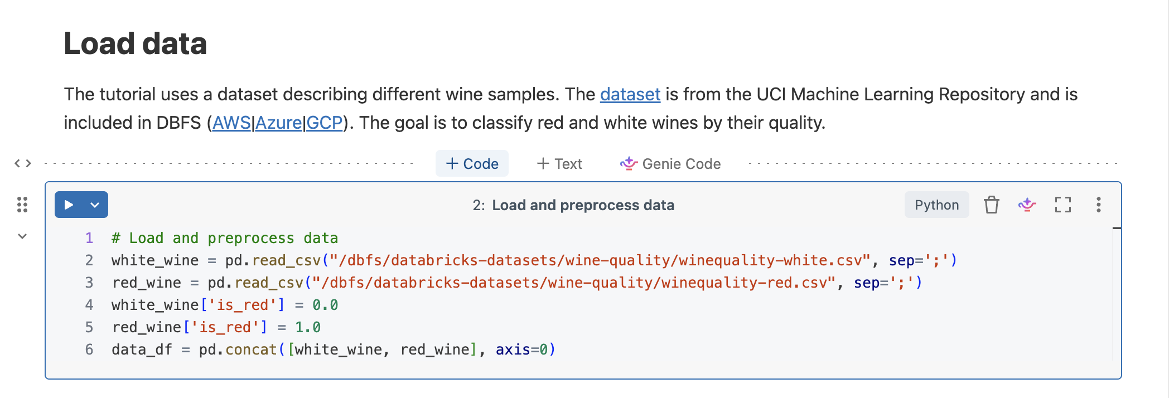
Notebook startup test
Confirm the identity and Spark session before the lesson
PYTHON
print('Learner session ready')
spark.range(5).show()
EXPECTED OUTPUT
id
0
1
2
3
4
If this fails, fix compute access before introducing DataFrames.
AZURE DATABRICKS • LESSONS 1–2
35
Notes:
Run the two lines separately. First confirm Python execution. Then confirm Spark execution. Ask learners why print can succeed even when a Spark operation fails. Expected: the Python process may run while compute or Spark access still has a problem.
Sources:
https://learn.microsoft.com/azure/databricks/notebooks/notebooks-manage
https://learn.microsoft.com/azure/databricks/compute/configure

Slide 36
PySpark functions alias
A Java comparison for from pyspark.sql import functions as F
PYTHON
JAVA IDEA
from pyspark.sql import functions as F
F.col('quantity')
F.round(F.col('quantity') * F.col('unit_price'), 2)
import static org.apache.spark.sql.functions.*;
col("quantity")
round(col("quantity").multiply(col("unit_price")), 2)
F is an alias
F.col builds an expression
Spark evaluates later
It refers to the pyspark.sql.functions module.
It identifies a DataFrame column for Spark.
The expression joins the logical plan.
AZURE DATABRICKS • LESSONS 1–2
36
Notes:
Use the Java static-import analogy, but explain the difference: F is a Python module alias. F.col returns a Spark Column expression, not the actual values from the dataset.
Sources:

Slide 37
Orders input data
Five rows make every calculation visible
order_id | product | quantity | unit_price
1001 | Keyboard | 2 | 45.00
1002 | Mouse | 1 | 25.00
1003 | Monitor | 2 | 220.00
1004 | Keyboard | 3 | 45.00
1005 | Mouse | 4 | 25.00
Prediction question: Which order will have the highest order_total?
AZURE DATABRICKS • LESSONS 1–2
37
Notes:
Give learners 20 seconds to calculate before showing the next slide. Expected answer: order 1003, because 2 multiplied by 220 equals 440.
Sources:

Slide 38
Order total calculation
quantity multiplied by unit_price
order_total = quantity × unit_price
Order 1001
Order 1003
Order 1005
Keyboard
2 × 45.00 = 90.00
Monitor
2 × 220.00 = 440.00
Mouse
4 × 25.00 = 100.00
round(..., 2) keeps the displayed monetary result at two decimal places.
AZURE DATABRICKS • LESSONS 1–2
38
Notes:
Calculate one row aloud and ask learners to calculate the other two. Explain that production currency calculations may require Decimal types and explicit rounding rules.
Sources:

Slide 39
DataFrame transformation walkthrough
Observe the table after each operation
1
filter(quantity > 0)
Rows remain 5
Removes invalid quantities
2
withColumn(order_total, ...)
Columns become 5
Adds a derived value
3
select(...)
Column order becomes explicit
Keeps the published schema clear
4
orderBy(desc(order_total))
Order 1003 appears first
Changes display order
ACTION
display(result_df.orderBy(F.desc('order_total')))
AZURE DATABRICKS • LESSONS 1–2
39
Notes:
Run one transformation at a time during the first demonstration. Ask which steps change row count, which change columns, and which only change display order. The final display is the action that requests results.
Sources:

Slide 40
Spark SQL aggregation result
Temporary view orders_work summarized by product
SQL
%sql
SELECT product, SUM(quantity) AS units,
ROUND(SUM(order_total), 2) AS revenue
FROM orders_work
GROUP BY product
ORDER BY revenue DESC
product | units | revenue
Monitor | 2 | 440.00
Keyboard | 5 | 225.00
Mouse | 5 | 125.00
Why does Monitor rank first even though Keyboard sells more units?
AZURE DATABRICKS • LESSONS 1–2
40
Notes:
Expected answer: Monitor has a higher unit price. Two monitor units produce 440.00, while five keyboard units produce 225.00. Explain that groupBy brings matching product keys together and may cause a shuffle.
Sources:

Slide 41
Temporary view and Delta table
Two names with different lifetimes
orders_work temporary view
training_lab.student_01.orders
Created with createOrReplaceTempView
Available in the current Spark session
Useful for Python-to-SQL analysis
Disappears when the session ends
Created with saveAsTable
Registered in Unity Catalog
Available to authorized users and jobs
Stores committed Delta versions
Class question: Which object should a scheduled job use tomorrow?
Expected answer: the governed Delta table.
AZURE DATABRICKS • LESSONS 1–2
41
Notes:
This distinction prevents a common beginner error. A temporary view is convenient for the current notebook session. A governed table provides a persistent, discoverable contract.
Sources:

Slide 42
Delta history example
Illustrative DESCRIBE HISTORY output after overwrite and append
version | operation | mode | rows in table | lesson event
1 | WRITE | Append | 6 | Added order 1006
0 | WRITE | Overwrite | 5 | Created the lab table
SQL
%sql
DESCRIBE HISTORY training_lab.student_01.orders;
History proves that the append created a second committed version.
AZURE DATABRICKS • LESSONS 1–2
42
Notes:
Tell learners that real history includes more columns and exact timestamps. The slide shows only the fields needed for the lesson. Ask which version contains five rows. Expected: version 0.
Sources:
https://learn.microsoft.com/azure/databricks/delta/tutorial

Slide 43
Time travel example
Compare the original version with the current table
VERSION 0
CURRENT
%sql
SELECT COUNT(*) AS original_rows
FROM training_lab.student_01.orders VERSION AS OF 0;
%sql
SELECT COUNT(*) AS current_rows
FROM training_lab.student_01.orders;
original_rows = 5
current_rows = 6
Always read DESCRIBE HISTORY before choosing a version number.
AZURE DATABRICKS • LESSONS 1–2
43
Notes:
Run DESCRIBE HISTORY first because reruns can change version numbers. Time travel supports audit and comparison, but retention settings determine how long old files remain available.
Sources:
https://learn.microsoft.com/azure/databricks/delta/tutorial

Slide 44
Permission error demonstration
Diagnose the object and privilege before changing access
PERMISSION_DENIED User does not have CREATE TABLE on training_lab.student_02
1
Confirm current_user()
Is the learner using the expected identity?
2
Read the three-level target
Did learner 01 accidentally use student_02?
3
Run SHOW GRANTS
Does the assigned schema include CREATE TABLE?
4
Apply the narrow correction
Fix the target name or one schema grant
AZURE DATABRICKS • LESSONS 1–2
44
Notes:
Do not solve the demonstration by granting admin. In the example, learner 01 likely used the student_02 target. Correct the object name first. If the assigned schema truly lacks a privilege, add only the missing grant.
Sources:

Slide 45
Independent learner challenge
Create and prove product_summary without copying the answer first
Requirement
Evidence
Explanation
Create product_summary in the assigned schema with product, units and revenue.
Show the table in Catalog Explorer and query it in revenue order.
State which aggregation created each column and why overwrite is acceptable in this isolated lab.
Pass condition Monitor 2 units 440.00 revenue
Trainer pause: allow 12 minutes before revealing the worked solution in the lab guide.
AZURE DATABRICKS • LESSONS 1–2
45
Notes:
Use this as the assessment. Help with questions, not by typing the full answer. A learner passes when the table exists, values are correct, and the learner can explain groupBy, sum, saveAsTable and the three-level name.
Sources:

